Slide 1

CS 106: Artificial Intelligence
Reinforcement Learning
Instructor: Ngoc-Hoang LUONG, PhD.
University of Information Technology (UIT), VNU-HCM
[These slides were adapted from the slides created by Dan Klein and Pieter Abbeel for CS188 Intro to AI at UC Berkeley. http://ai.berkeley.edu.]
Notes:
Please retain proper attribution, including the reference to ai.berkeley.edu. Thanks!

Slide 2

Reinforcement Learning

Slide 3
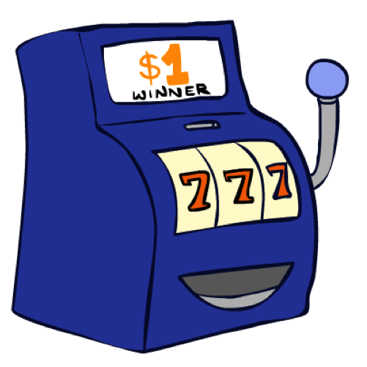
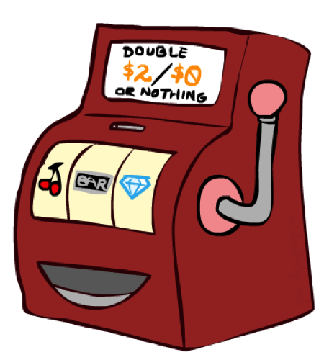

Double Bandits

Slide 4
Double-Bandit MDP
Actions: Blue, Red
States: Win, Lose
No discount
10 time steps
Both states have the same value
0.25 $0
0.75
$2
W
L
0.25
$0
$1
1.0
$1
1.0
0.75 $2

Slide 5
Offline Planning
Solving MDPs is offline planning
You determine all quantities through computation
You need to know the details of the MDP
You do not actually play the game!
No discount
10 time steps
Both states have the same value
0.25 $0
Value
0.75
$2
W
0.25
$0
Play Red
15
L
$1
1.0
$1
1.0
0.75 $2
Play Blue
10
Notes:
Did we play the game yet? No, we just thought really hard about what to do. Did we get 150? No.

Slide 6
Let’s Play!
$2
$2
$0
$2
$2
$2
$2
$0
$0
$0
Notes:
The playing actually happened! Real fake money!

Slide 7
Online Planning
Rules changed! Red’s win chance is different.
?? $0
??
$2
W
L
??
$0
$1
?
$1
??
?? $2
Notes:
Whats the optimal policy? We don’t know the mdp so no offline planning. What do we do? Give up and go home?

Slide 8
Let’s Play!
$1
$1
$1
$0
$0
$0
$2
Notes:
Need to spend money to figure out what’s optimal

Slide 9
What Just Happened?
That wasn’t planning, it was learning!
Specifically, reinforcement learning
There was an MDP, but you couldn’t solve it with just computation
You needed to actually act to figure it out
Important ideas in reinforcement learning that came up
Exploration: you have to try unknown actions to get information
Exploitation: eventually, you have to use what you know
Regret: even if you learn intelligently, you make mistakes
Sampling: because of chance, you have to try things repeatedly
Difficulty: learning can be much harder than solving a known MDP

Slide 10
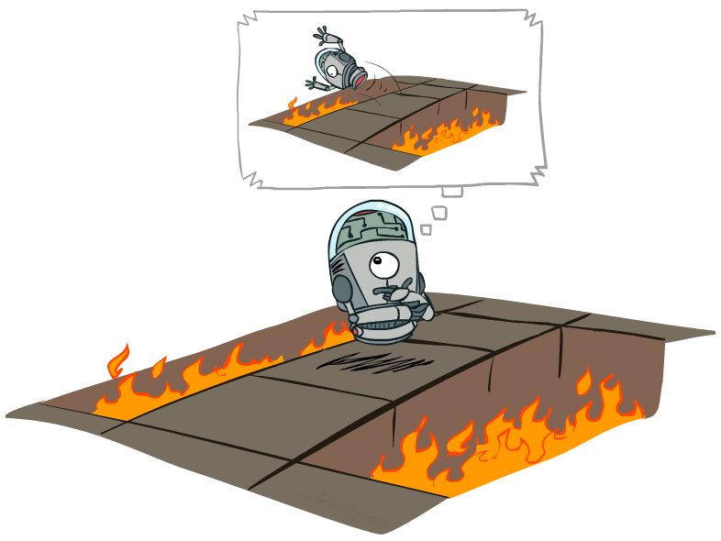
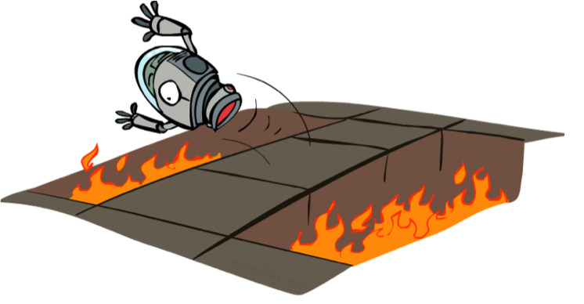
Offline (MDPs) vs. Online (RL)
Offline Solution
Online Learning

Slide 11
Reinforcement Learning
Agent
State: s
Reward: r
Actions: a
Environment
Basic idea:
Receive feedback in the form of rewards
Agent’s utility is defined by the reward function
Must (learn to) act so as to maximize expected rewards
All learning is based on observed samples of outcomes!
Notes:
Show robot-soccer learning to walk videos (UT Austin):
? Show snake robot:

Slide 12
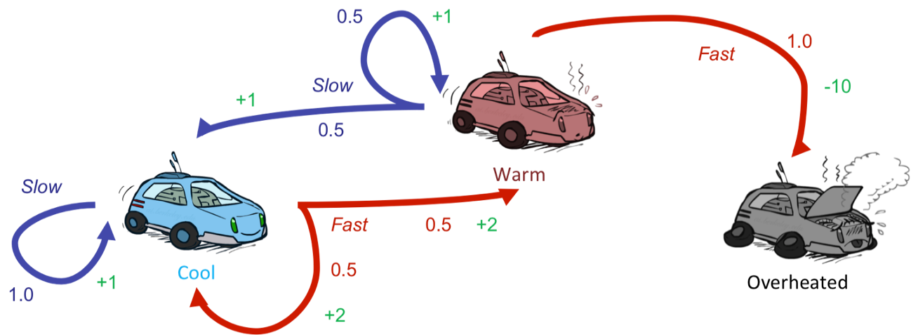
Reinforcement Learning
Still assume a Markov decision process (MDP):
A set of states s ∈ S
A set of actions (per state) A
A model T(s,a,s’) = P(s’|s,a)
A reward function R(s,a,s’)
Still looking for a policy π(s)
New twist: don’t know T or R
i.e. we don’t know which states are good or what the actions do
Must actually try actions and states out to learn

Slide 13
Offline (MDPs) vs. Online (RL)
Offline Solution
Online Learning

Slide 14

Model-Based Learning

Slide 15

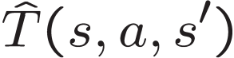

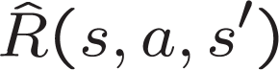
Model-Based Learning
Model-Based Idea:
Learn an approximate model based on experiences
Solve for values as if the learned model were correct
Step 1: Learn empirical MDP model
Count outcomes s’ for each s, a
Normalize to give an estimate of
Discover each when we experience (s, a, s’)
Step 2: Solve the learned MDP
For example, use value iteration, as before

Slide 16
Example: Model-Based Learning
Input Policy π
Observed Episodes (Training)
Learned Model
Episode 1
Episode 2
T(s,a,s’).
T(B, east, C) = 1.00
T(C, east, D) = 0.75
T(C, east, A) = 0.25
…
R(s,a,s’).
R(B, east, C) = -1
R(C, east, D) = -1
R(D, exit, x) = +10
…
 | A
B | C | D
 | E
B, east, C, -1
C, east, D, -1
D, exit, x, +10
B, east, C, -1
C, east, D, -1
D, exit, x, +10
T(B, east, C) =
T(C, east, D) =
T(C, east, A) =
…
R
R(B, east, C) =
R(C, east, D) =
R(D, exit, x) =
…
Episode 3
Episode 4
E, north, C, -1
C, east, D, -1
D, exit, x, +10
E, north, C, -1
C, east, A, -1
A, exit, x, -10
Assume: γ = 1

Slide 17
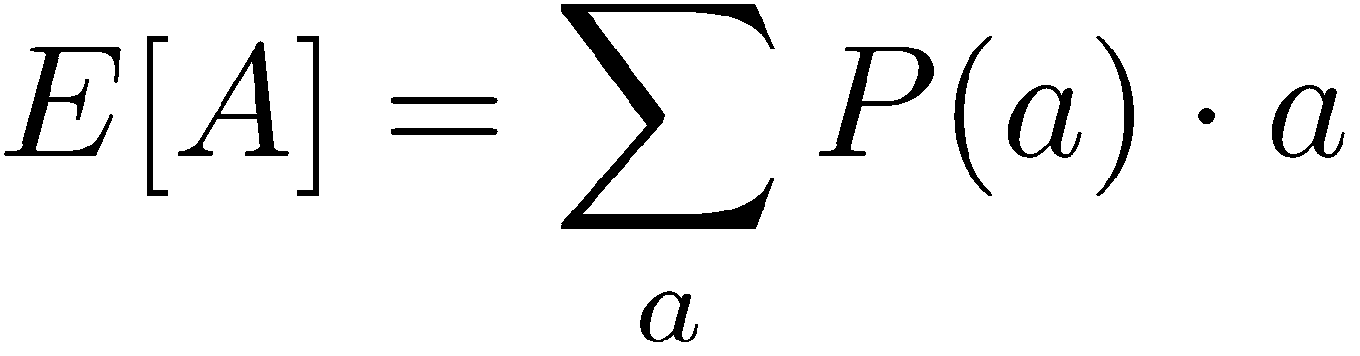
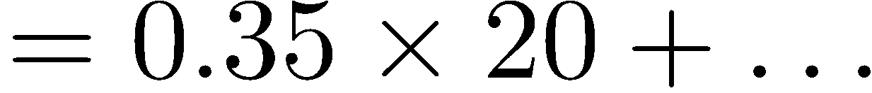
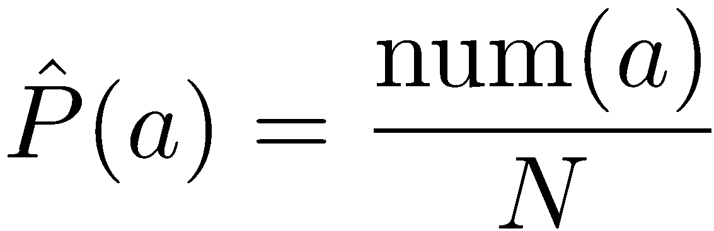
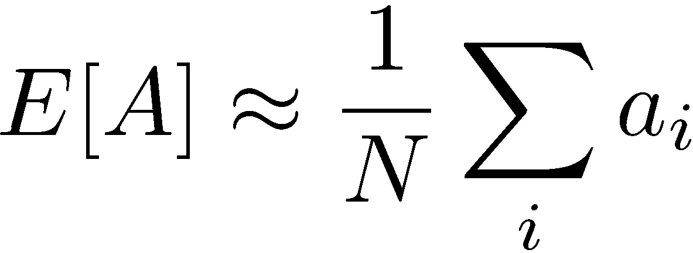
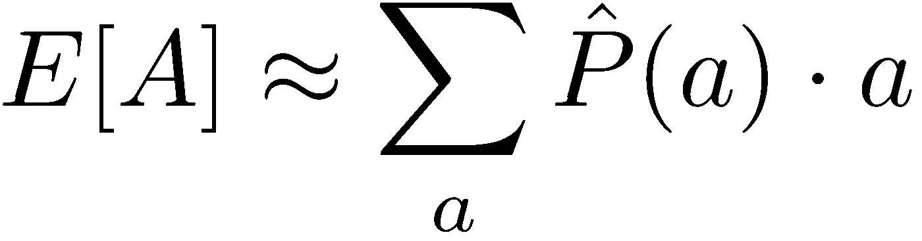
Example: Expected Age
Goal: Compute expected age of CS106 students
Known P(A)
Without P(A), instead collect samples [a₁, a₂, … a_{N}]
Unknown P(A): “Model Based”
Unknown P(A): “Model Free”
Why does this work? Because eventually you learn the right model.
Why does this work? Because samples appear with the right frequencies.

Slide 18

Model-Free Learning

Slide 19
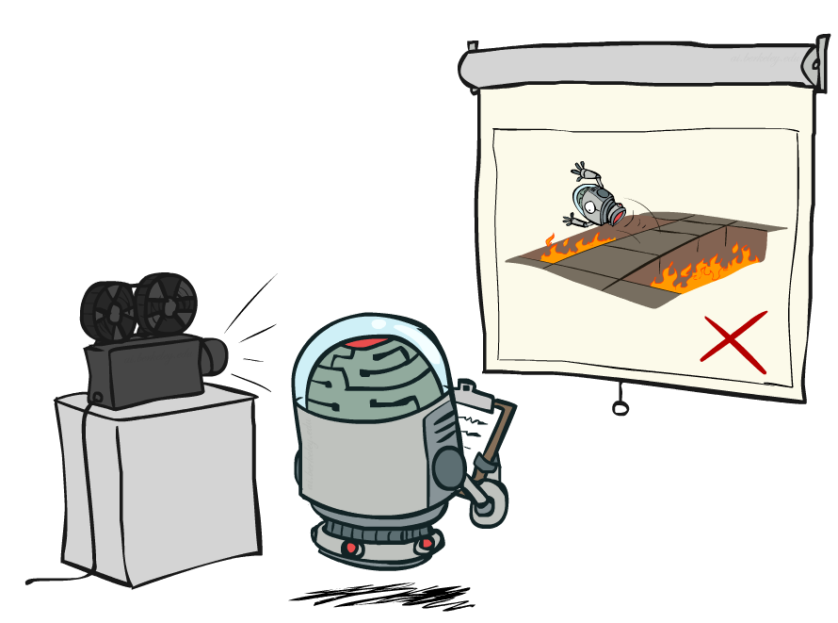
Passive Reinforcement Learning

Slide 20

Passive Reinforcement Learning
Simplified task: policy evaluation
Input: a fixed policy π(s)
You don’t know the transitions T(s,a,s’)
You don’t know the rewards R(s,a,s’)
Goal: learn the state values
In this case:
Learner is “along for the ride”
No choice about what actions to take
Just execute the policy and learn from experience
This is NOT offline planning! You actually take actions in the world.

Slide 21
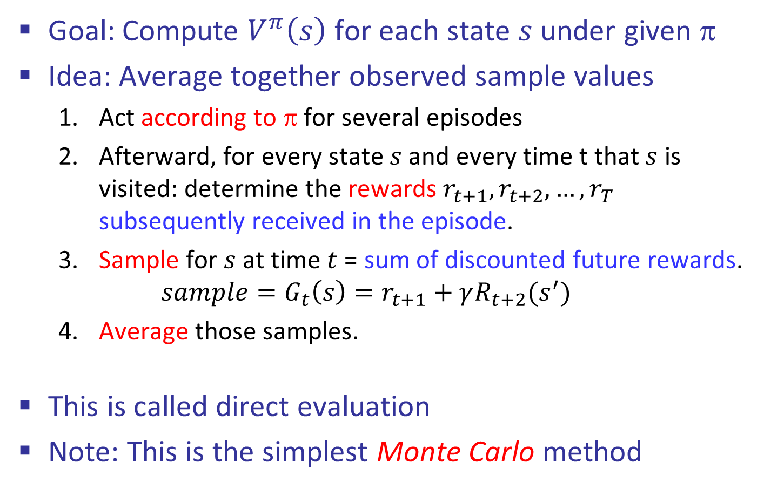
Direct Evaluation
Goal: Compute $V^{π}\left(s\right)$ for each state $s$under given π
Idea: Average together observed sample values
Act according to π for several episodes
Afterward, for every state $s$ and every time t that $s$ is visited: determine the rewards $r_{t+1},r_{t+2},…,r_{T}$ subsequently received in the episode.
Sample for $s$ at time $t$ = sum of discounted future rewards.
$$sample=G_{t}\left(s\right)=r_{t+1}+γR_{t+2}(s^{′})$$
Average those samples.
This is called direct evaluation
Note: This is the simplest Monte Carlo method

Slide 22
Example: Direct Evaluation
Input Policy π
Observed Episodes (Training)
Output Values
Episode 1
Episode 2
 | A
B | C | D
 | E
 | A
B | C | D
 | E
B, east, C, -1
C, east, D, -1
D, exit, x, +10
B, east, C, -1
C, east, D, -1
D, exit, x, +10
-10
+8
+4
+10
Episode 3
Episode 4
-2
E, north, C, -1
C, east, D, -1
D, exit, x, +10
E, north, C, -1
C, east, A, -1
A, exit, x, -10
Assume: γ = 1

Slide 23
Problems with Direct Evaluation
What’s good about direct evaluation?
It’s easy to understand
It doesn’t require any knowledge of T, R
It eventually computes the correct average values, using just sample transitions
What bad about it?
It wastes information about state connections
Each state must be learned separately
So, it takes a long time to learn
Output Values
 | A
B | C | D
 | E
-10
+8
+4
+10
-2
If B and E both go to C under this policy, how can their values be different?

Slide 24
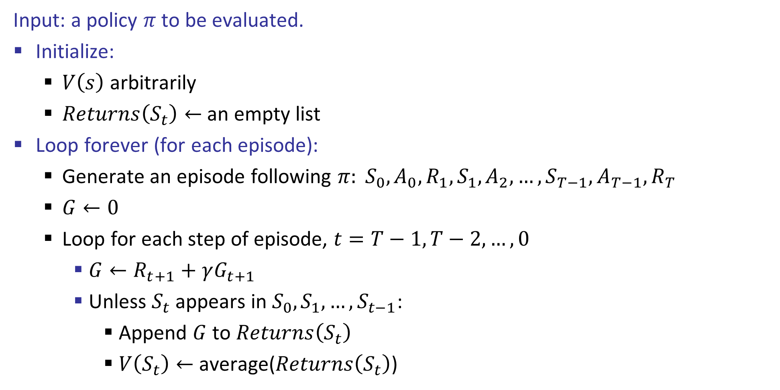
First-visit Monte Carlo Policy Evaluation
Input: a policy $π$ to be evaluated.
Initialize:
$V\left(s\right)$ arbitrarily
$Returns\left(S_{t}\right)←$ an empty list
Loop forever (for each episode):
Generate an episode following $π: S_{0},A_{0},R_{1},S_{1},A_{2},…,S_{T−1},A_{T−1},R_{T}$
$G←0$
Loop for each step of episode, $t=T−1,T−2,…,0$
$G←R_{t+1}+γG_{t+1}$
Unless $S_{t}$ appears in $S_{0},S_{1},…,S_{t−1}$:
Append $G$ to $Returns\left(S_{t}\right)$
$V\left(S_{t}\right)←$ average($Returns\left(S_{t}\right)$)

Slide 25

Why Not Use Policy Evaluation?
s
Simplified Bellman updates calculate V for a fixed policy:
Each round, replace V with a one-step-look-ahead layer over V
This approach fully exploited the connections between the states
Unfortunately, we need T and R to do it!
Key question: how can we do this update to V without knowing T and R?
In other words, how to we take a weighted average without knowing the weights?
π(s)
s, π(s)
s, π(s),s’
s’

Slide 26
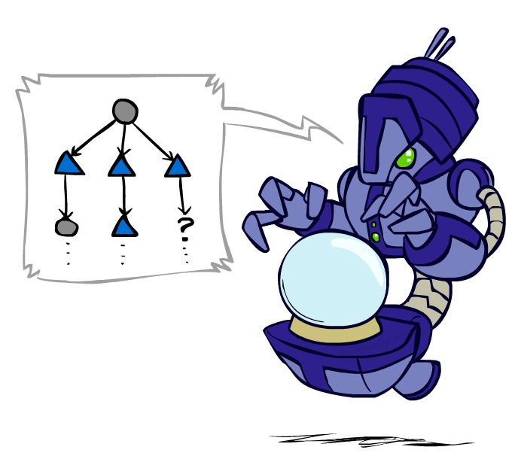
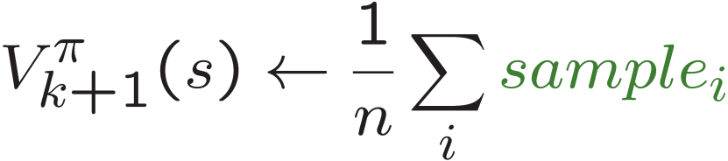
Sample-Based Policy Evaluation?
We want to improve our estimate of V by computing these averages:
Idea: Take samples of outcomes s’ (by doing the action!) and average
s
π(s)
s, π(s)
s, π(s),s’
s₁'
s₂'
s'
s₃'
Almost! But we can’t rewind time to get sample after sample from state s.

Slide 27
Temporal Difference Learning
Big idea: learn from every experience!
Update V(s) each time we experience a transition (s, a, s’, r)
Likely outcomes s’ will contribute updates more often
Temporal difference learning of values
Policy still fixed, still doing evaluation!
Move values toward value of whatever successor occurs: running average
s
π(s)
s, π(s)
s’
Sample of V(s):
Update to V(s):
Same update:

Slide 28
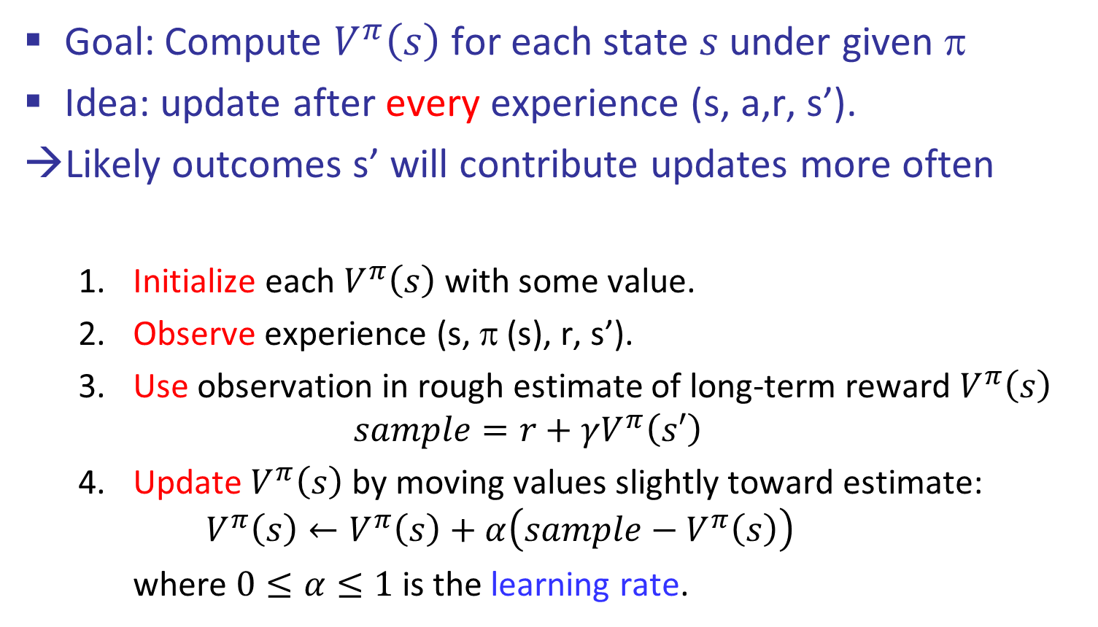
Temporal Difference Learning
Goal: Compute $V^{π}\left(s\right)$ for each state $s$under given π
Idea: update after every experience (s, a,r, s’).
Likely outcomes s’ will contribute updates more often
Initialize each $V^{π}\left(s\right)$ with some value.
Observe experience (s, π (s), r, s’).
Use observation in rough estimate of long-term reward $V^{π}\left(s\right)$
$$sample=r+γV^{π}\left(s′\right)$$
Update $V^{π}\left(s\right)$ by moving values slightly toward estimate:
$$V^{π}\left(s\right)←V^{π}\left(s\right)+α\left(sample−V^{π}\left(s\right)\right)$$
where $0≤α≤1$ is the learning rate.

Slide 29
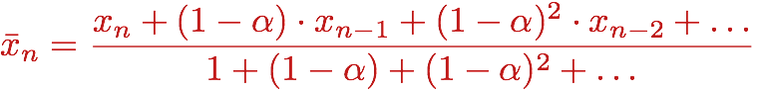
Exponential Moving Average
Exponential moving average
The running interpolation update:
Makes recent samples more important:
Forgets about the past (distant past values were wrong anyway)
Decreasing learning rate (alpha) can give converging averages

Slide 30
Example: Temporal Difference Learning
States
Observed Transitions
B, east, C, -2
C, east, D, -2
 | A
B | C | D
 | E
 | 0
0 | 0 | 8
 | 0
 | 0
-1 | 0 | 8
 | 0
 | 0
-1 | 3 | 8
 | 0
Assume: γ = 1, α = 1/2
$$V^{π}\left(s\right)←\left(1−α\right)V^{π}\left(s\right)+α∙sample$$
$$V^{π}\left(C\right)←\left(1−α\right)V^{π}\left(C\right)+α(r+γV^{π}\left(D\right))$$
$$V^{π}\left(B\right)←\left(1−α\right)V^{π}\left(B\right)+α(r+γV^{π}\left(C\right))$$
$$V^{π}\left(C\right)←V^{π}\left(C\right)+α(r+γV^{π}\left(D\right)−V^{π}\left(C\right))$$
$$V^{π}\left(B\right)←V^{π}\left(B\right)+α(r+γV^{π}\left(C\right)−V^{π}\left(B\right))$$

Slide 31
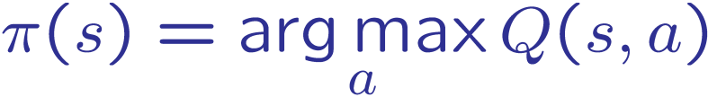
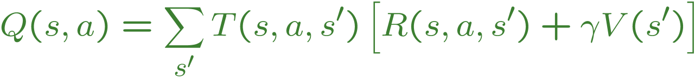
Problems with TD Value Learning
TD value leaning is a model-free way to do policy evaluation, mimicking Bellman updates with running sample averages
However, if we want to turn values into a (new) policy, we’re sunk:
Idea: learn Q-values, not values
Makes action selection model-free too!
s
a
s, a
s,a,s’
s’

Slide 32
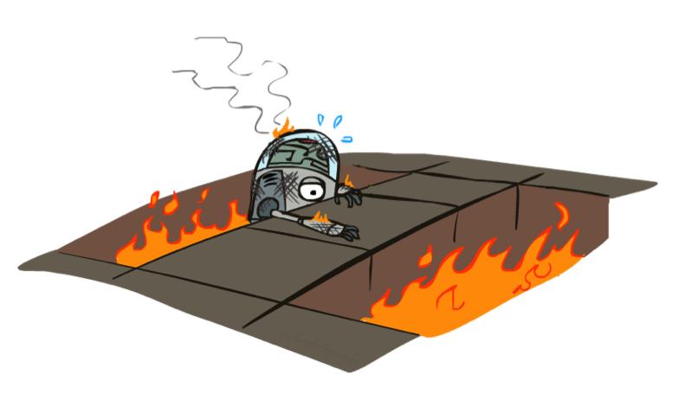
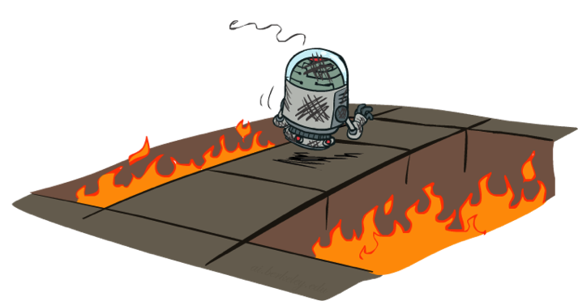
Active Reinforcement Learning

Slide 33
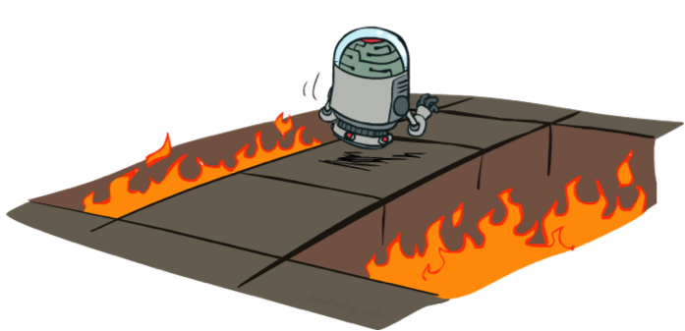
Active Reinforcement Learning
Full reinforcement learning: optimal policies (like value iteration)
You don’t know the transitions T(s,a,s’)
You don’t know the rewards R(s,a,s’)
You choose the actions now
Goal: learn the optimal policy / values
In this case:
Learner makes choices!
Fundamental tradeoff: exploration vs. exploitation
This is NOT offline planning! You actually take actions in the world and find out what happens…

Slide 34
Detour: Q-Value Iteration
Value iteration: find successive (depth-limited) values
Start with V₀(s) = 0, which we know is right
Given V_{k}, calculate V_{k+1} values for all states:
But Q-values are more useful, so compute them instead
Start with Q₀(s,a) = 0, which we know is right
Given Q_{k}, calculate the depth Q_{k+1} q-values for all q-states:

Slide 35
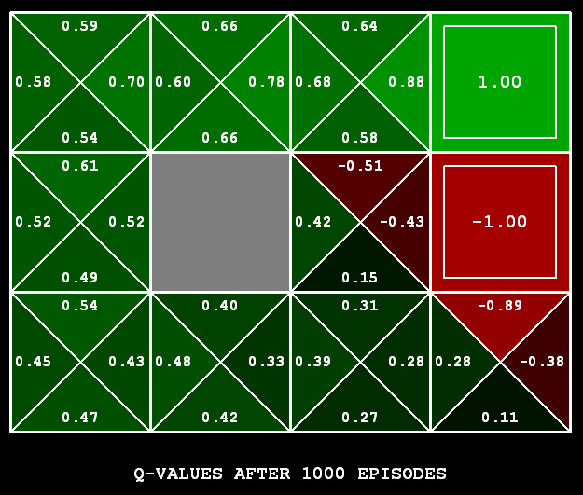
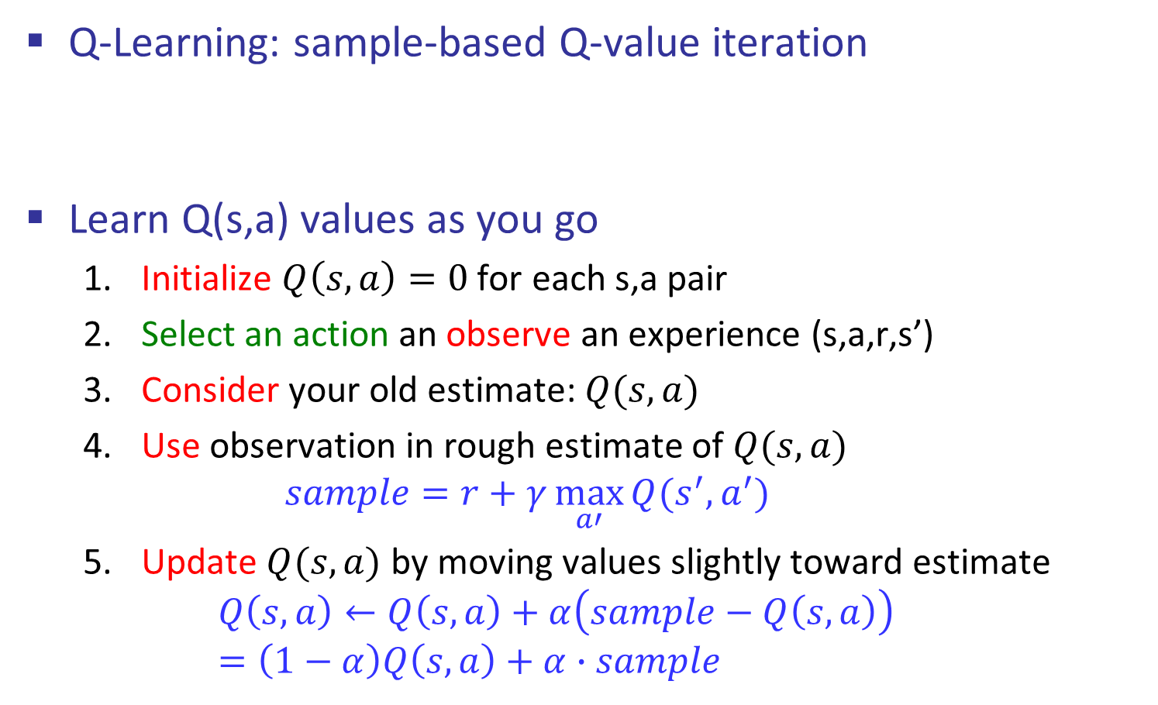
Q-Learning
Q-Learning: sample-based Q-value iteration
Learn Q(s,a) values as you go
Initialize $Q\left(s,a\right)=0$ for each s,a pair
Select an action an observe an experience (s,a,r,s’)
Consider your old estimate: $Q(s,a)$
Use observation in rough estimate of $Q(s,a)$
$$sample=r+γ\max_{a′}{Q(s^{′},a^{′})}$$
Update $Q(s,a)$ by moving values slightly toward estimate
$$Q\left(s,a\right)←Q\left(s,a\right)+α\left(sample−Q\left(s,a\right)\right)=\left(1−α\right)Q\left(s,a\right)+α∙sample$$
[Demo: Q-learning – gridworld (L10D2)]

Slide 36

Video of Demo Q-Learning -- Gridworld

Slide 37

Q-Learning Properties
Amazing result: Q-learning converges to optimal policy -- even if you’re acting suboptimally!
This is called off-policy learning
Caveats:
You have to explore enough
You have to eventually make the learning rate
small enough
… but not decrease it too quickly
Basically, in the limit, it doesn’t matter how you select actions (!)

Slide 38
Summary
Reinforcement Learning: learn from experience, not from a ‘teacher’
RL problems can be cast as MDPs with unknown T and R
Model-based RL: estimate R and T from experience
Model-free RL: estimate V(s) or Q(s,a) from experience. Q-Learning can give optimal policies.

Slide 39
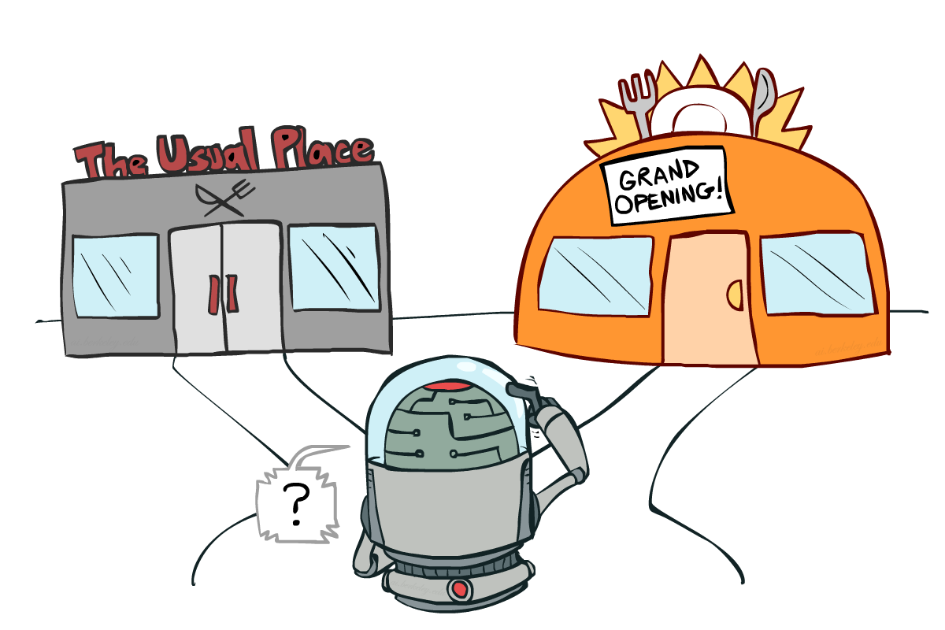
Exploration vs. Exploitation

Slide 40
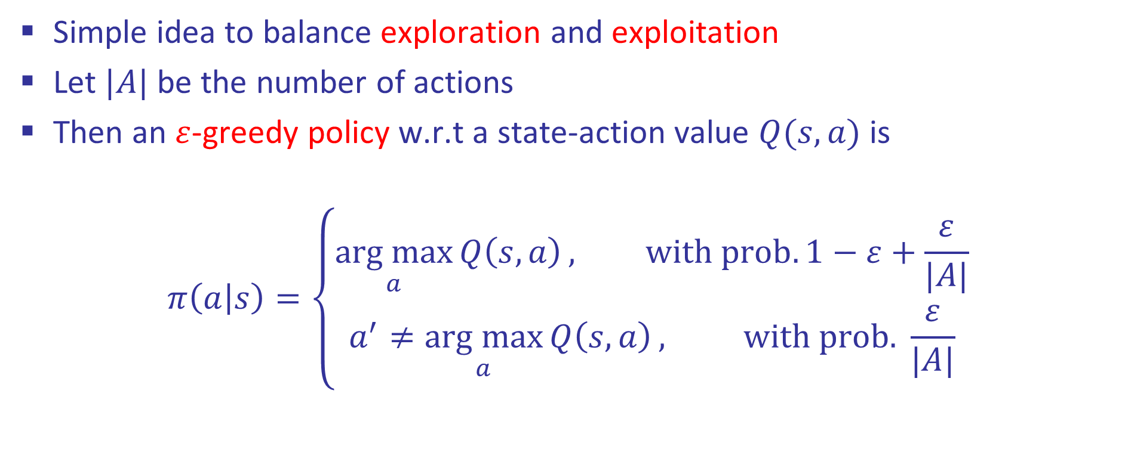

$ε$-greedy Policies
Simple idea to balance exploration and exploitation
Let $|A|$ be the number of actions
Then an $ε$-greedy policy w.r.t a state-action value $Q(s,a)$ is
$$π\left(a | s\right)=\left\{\begin{aligned}\underset{a}{arg max}{Q\left(s,a\right)}, with prob. 1−ε+\frac{ε}{|A|} \\ a^{′}≠\underset{a}{arg max}{Q\left(s,a\right)}, with prob. \frac{ε}{|A|}\end{aligned}\right.$$

Slide 41
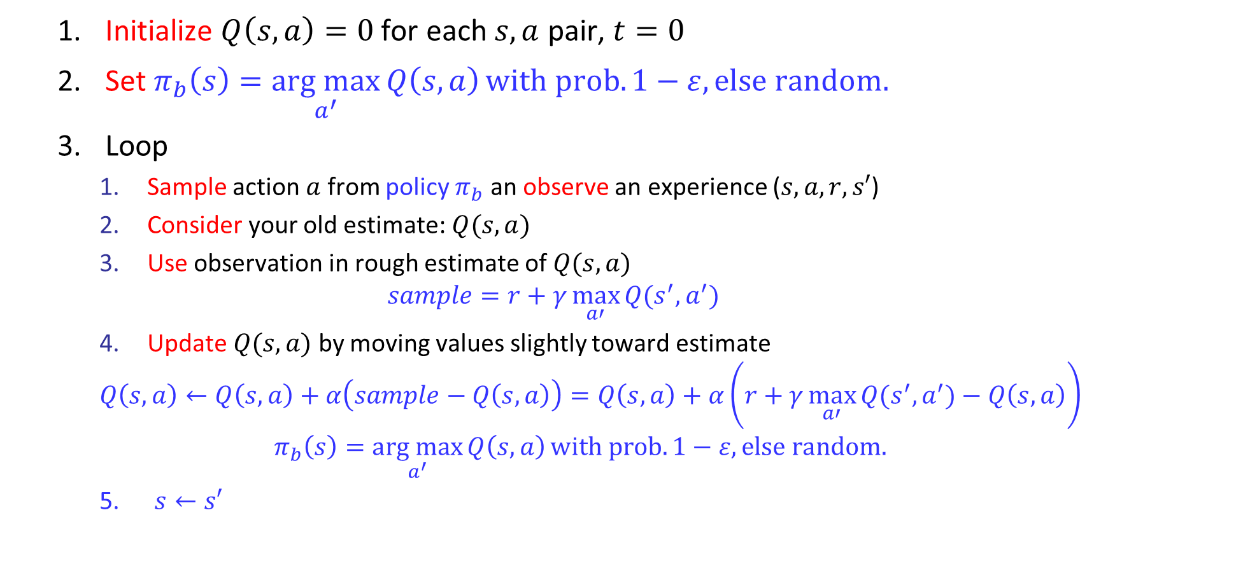

Q-Learning with $ε$-greedy Exploration
Initialize $Q\left(s,a\right)=0$ for each $s,a$ pair, $t=0$
Set $π_{b}\left(s\right)=\underset{a^{′}}{arg max}{Q\left(s,a\right)}with prob. 1−ε, else random.$
Loop
Sample action $a$ from policy $π_{b}$ an observe an experience ($s,a,r,s′$)
Consider your old estimate: $Q(s,a)$
Use observation in rough estimate of $Q(s,a)$
$$sample=r+γ\max_{a′}{Q(s^{′},a^{′})}$$
Update $Q(s,a)$ by moving values slightly toward estimate
$$Q\left(s,a\right)←Q\left(s,a\right)+α\left(sample−Q\left(s,a\right)\right)=Q\left(s,a\right)+α\left(r+γ\max_{a′}{Q(s^{′},a^{′})}−Q\left(s,a\right)\right)$$
$$π_{b}\left(s\right)=\underset{a^{′}}{arg max}{Q\left(s,a\right)}with prob. 1−ε, else random.$$
5. $s←s′$

Slide 42

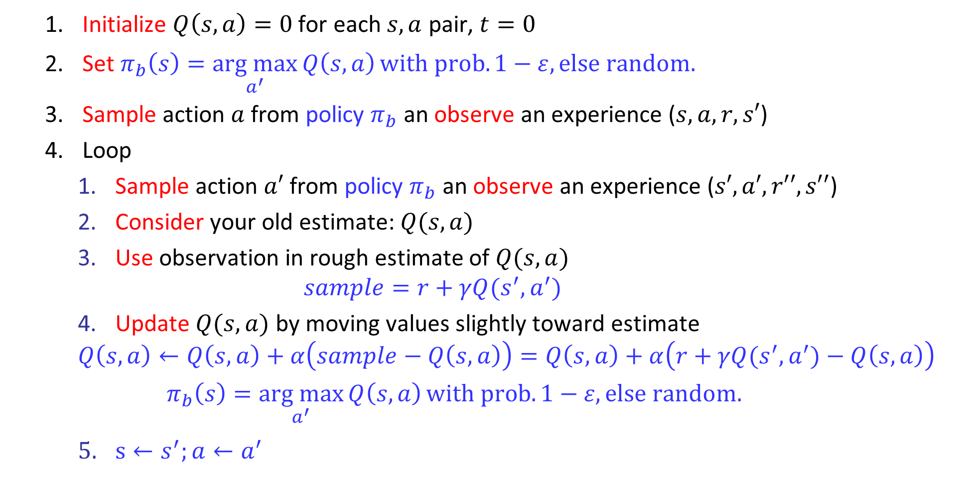
SARSA with $ε$-greedy Exploration
Initialize $Q\left(s,a\right)=0$ for each $s,a$ pair, $t=0$
Set $π_{b}\left(s\right)=\underset{a^{′}}{arg max}{Q\left(s,a\right)}with prob. 1−ε, else random.$
Sample action $a$ from policy $π_{b}$ an observe an experience ($s,a,r,s′$)
Loop
Sample action $a′$ from policy $π_{b}$ an observe an experience ($s′,a′,r′′,s′′$)
Consider your old estimate: $Q(s,a)$
Use observation in rough estimate of $Q(s,a)$
$$sample=r+γQ(s^{′},a^{′})$$
Update $Q(s,a)$ by moving values slightly toward estimate
$$Q\left(s,a\right)←Q\left(s,a\right)+α\left(sample−Q\left(s,a\right)\right)=Q\left(s,a\right)+α\left(r+γQ(s^{′},a^{′})−Q\left(s,a\right)\right)$$
$$π_{b}\left(s\right)=\underset{a^{′}}{arg max}{Q\left(s,a\right)}with prob. 1−ε, else random.$$
$s←s^{′};a←a^{′}$

Slide 43
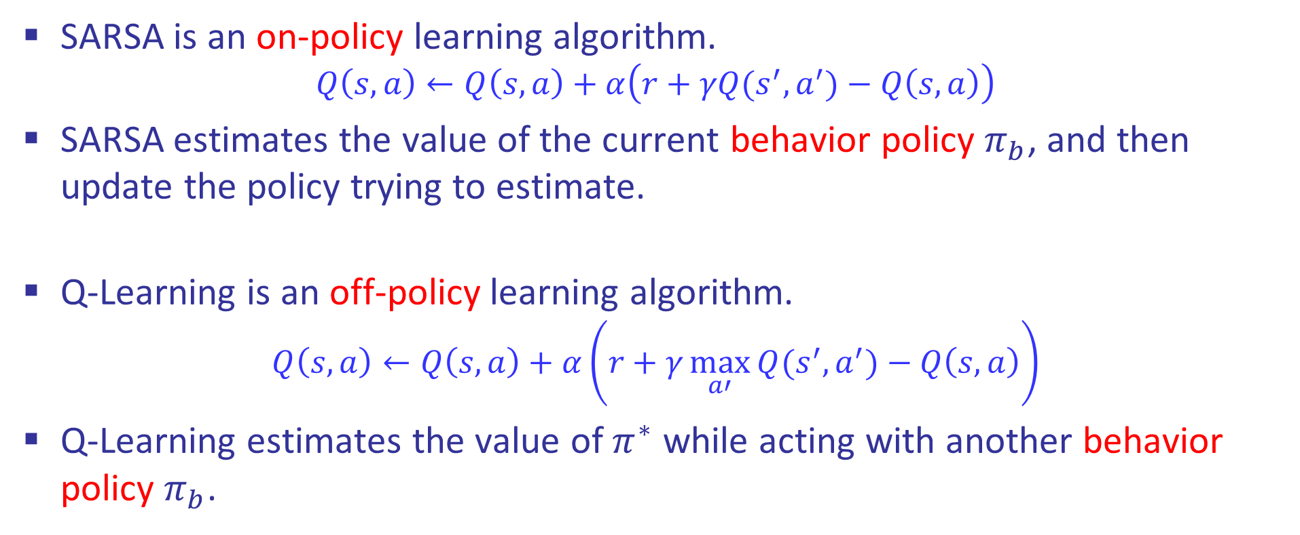
SARSA & Q-Learning
SARSA is an on-policy learning algorithm.
$$Q\left(s,a\right)←Q\left(s,a\right)+α\left(r+γQ(s^{′},a^{′})−Q\left(s,a\right)\right)$$
SARSA estimates the value of the current behavior policy $π_{b}$, and then update the policy trying to estimate.
Q-Learning is an off-policy learning algorithm.
$$Q\left(s,a\right)←Q\left(s,a\right)+α\left(r+γ\max_{a′}{Q(s^{′},a^{′})}−Q\left(s,a\right)\right)$$
Q-Learning estimates the value of $π^{∗}$ while acting with another behavior policy $π_{b}$.

Slide 44
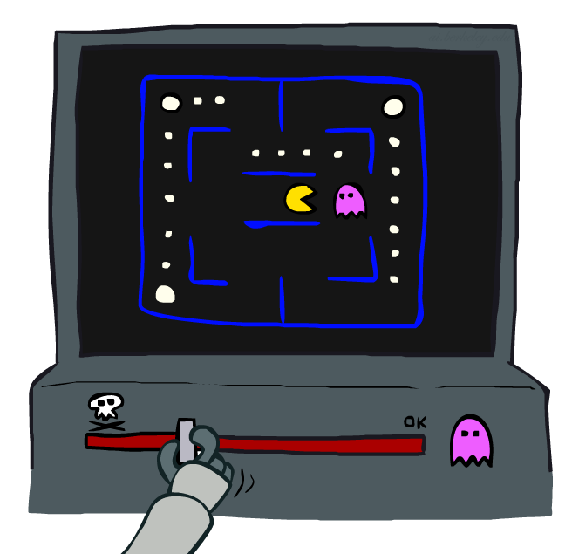
Approximate Q-Learning

Slide 45


Generalizing Across States
Basic Q-Learning keeps a table of all q-values
In realistic situations, we cannot possibly learn about every single state!
Too many states to visit them all in training
Too many states to hold the q-tables in memory
Instead, we want to generalize:
Learn about some small number of training states from experience
Generalize that experience to new, similar situations
This is a fundamental idea in machine learning, and we’ll see it over and over again
[demo – RL pacman]

Slide 46
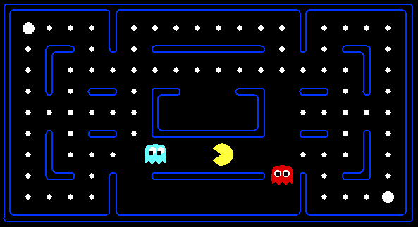



Example: Pacman
Let’s say we discover through experience that this state is bad:
In naïve q-learning, we know nothing about this state:
Or even this one!

Slide 47
Feature-Based Representations
Solution: describe a state using a vector of features (properties)
Features are functions from states to real numbers (often 0/1) that capture important properties of the state
Example features:
Distance to closest ghost
Distance to closest dot
Number of ghosts
1 / (dist to dot)²
Is Pacman in a tunnel? (0/1)
…… etc.
Is it the exact state on this slide?
Can also describe a q-state (s, a) with features (e.g. action moves closer to food)

Slide 48
Linear Value Functions
Using a feature representation, we can write a q function (or value function) for any state using a few weights:
Advantage: our experience is summed up in a few powerful numbers
Disadvantage: states may share features but actually be very different in value!

Slide 49

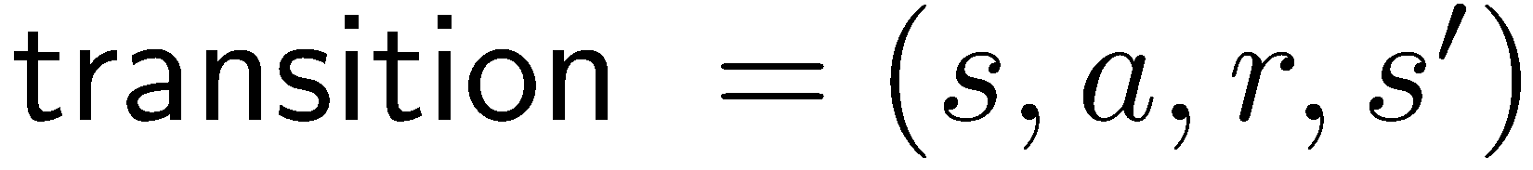
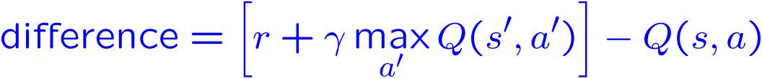
Approximate Q-Learning
Q-learning with linear Q-functions:
Intuitive interpretation:
Adjust weights of active features
E.g., if something unexpectedly bad happens, blame the features that were on: disprefer all states with that state’s features
Formal justification: online least squares
Exact Q’s
Approximate Q’s

Slide 50
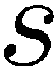
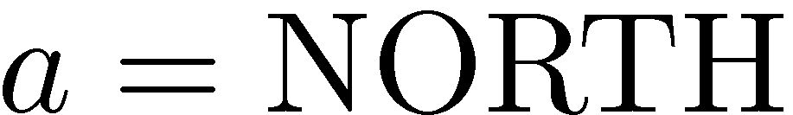
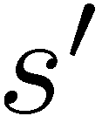
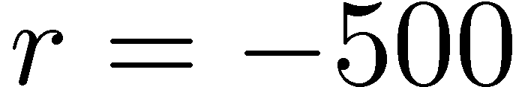
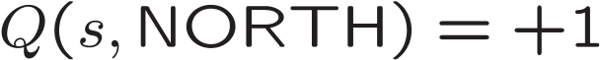
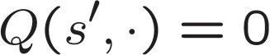
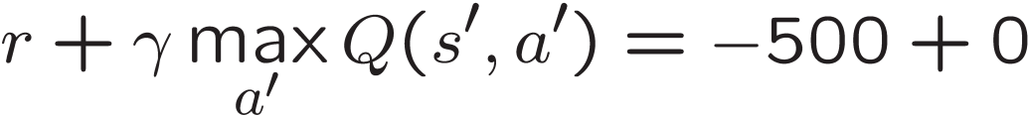
Example: Q-Pacman
Q(s,a)=
Notes:
now when you run into ghosts you can figure out ghosts are bad; dots are good

Slide 51
Video of Demo Approximate Q-Learning -- Pacman

Slide 52
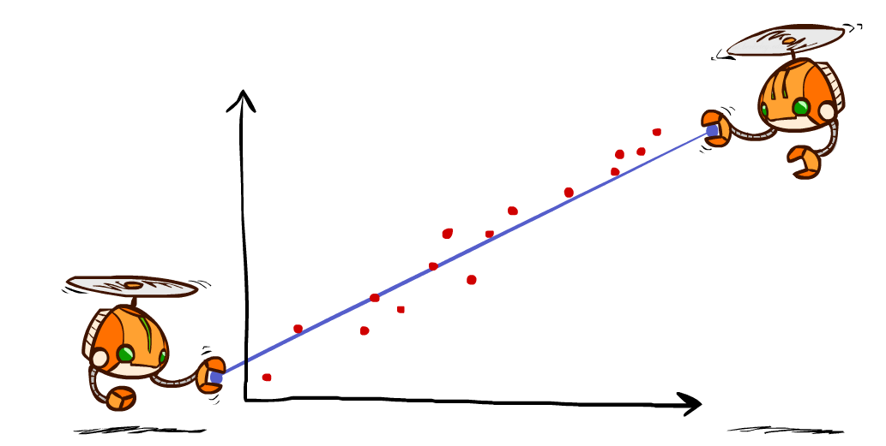
Q-Learning and Least Squares

Slide 53

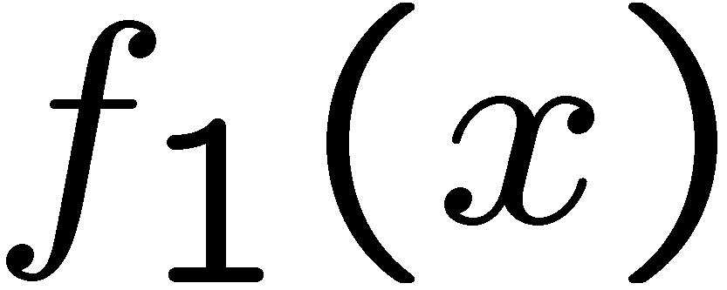
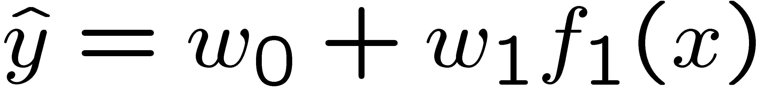
Linear Approximation: Regression
40
26
24
20
22
20
30
20
40
0
0
20
30
10
20
0
10
0
Prediction:
Prediction:
Notes:
Figure 1: scatter(1:20,10+(1:20)+2*randn(1,20),'k','filled'); a=axis; a(3)=0; axis(a);

Slide 54
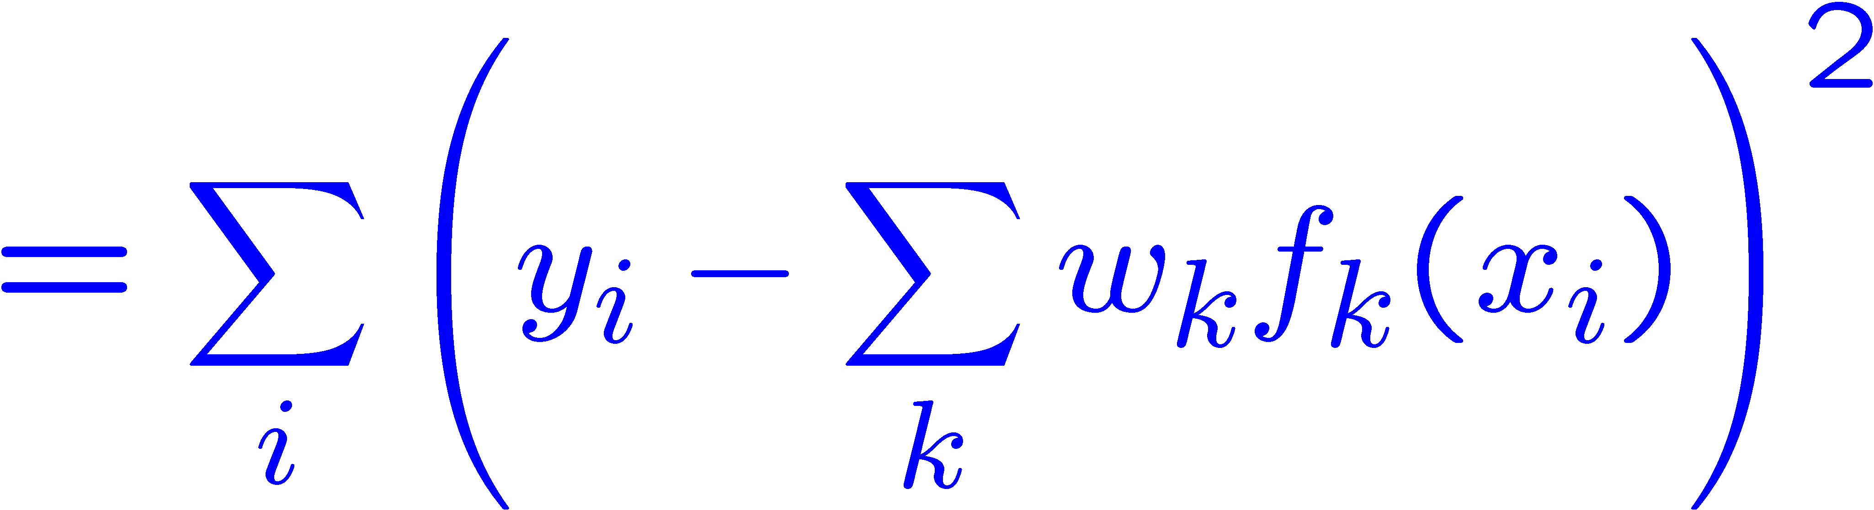
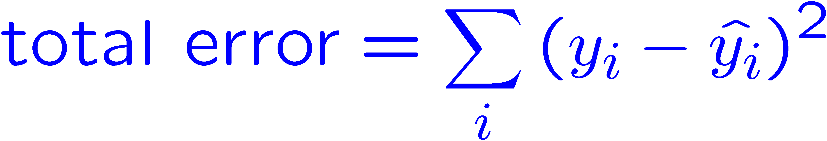
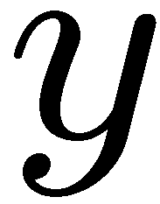


Optimization: Least Squares
Error or “residual”
Observation
Prediction
0
0
20
Notes:
Figure 1: scatter(1:20,10+(1:20)+2*randn(1,20),'k','filled'); a=axis; a(3)=0; axis(a);

Slide 55
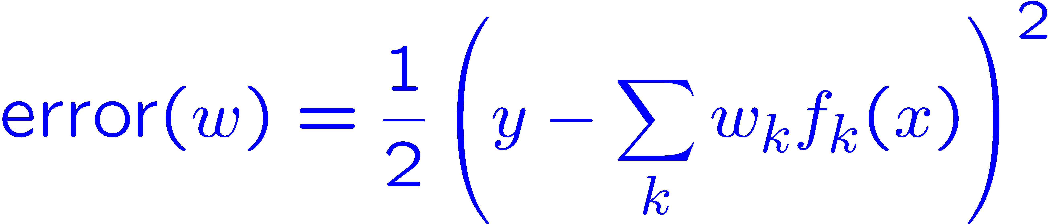
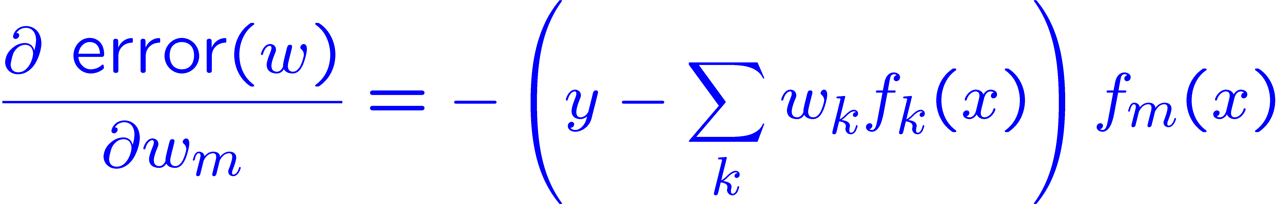

Minimizing Error
Imagine we had only one point x, with features f(x), target value y, and weights w:
Approximate q update explained:
“target”
“prediction”

Slide 56
More Powerful Function Approximation
Linear:
Polynomial:
Neural Network:
Learn These Too

Slide 57
More Powerful Function Approximation
Summary of iterative feature update equation!

Slide 58

Overfitting: Why Limiting Capacity Can Help
30
25
20
Degree 15 polynomial
15
10
5
0
-5
-10
-15
0
2
4
6
8
10
12
14
16
18
20

